Slide 1




Semi-Supervised Learning
Dr. Sam Abuomar
Dept. of Engineering, Computing, and Mathematical Sciences

Slide 2



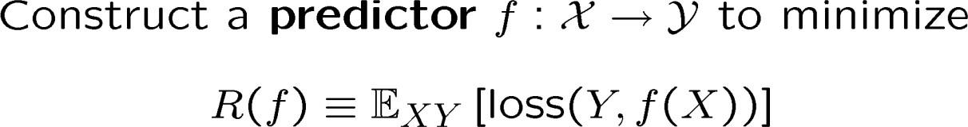




Supervised Learning
Feature Space
Label Space
Goal:
Optimal predictor (such as Bayes Rule) depends on unknown P_{XY}, so instead
learn a good prediction rule from training data
Learning algorithm
Labeled
2

Slide 3

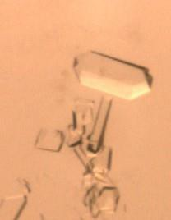
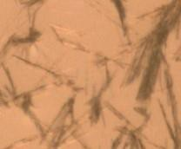
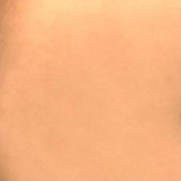




Labeled and Unlabeled data
“Crystal” “Needle” “Empty”
“0” “1” “2” …
Human expert/ Special equipment/ Experiment
“Sports” “News” “Science”
…
Cheap and abundant !
Expensive and scarce !
3

Slide 4




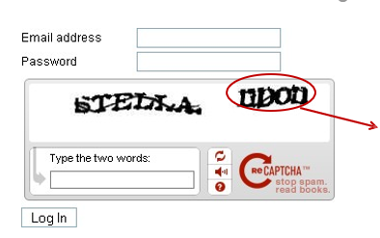
Free-of-cost labels?
Luis von Ahn: Games with a purpose (ReCaptcha)
Word challenging to OCR (Optical Character Recognition)
You provide a free label!
4

Slide 5



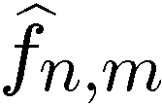
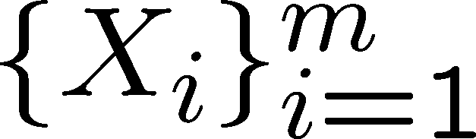
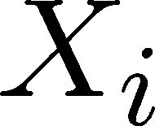
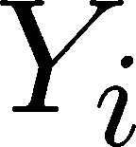

Semi-Supervised learning
Learning algorithm
Supervised learning (SL)
“Crystal”
Semi-Supervised learning (SSL)
Goal: Learn a better prediction rule than based on labeled data alone.
5

Slide 6



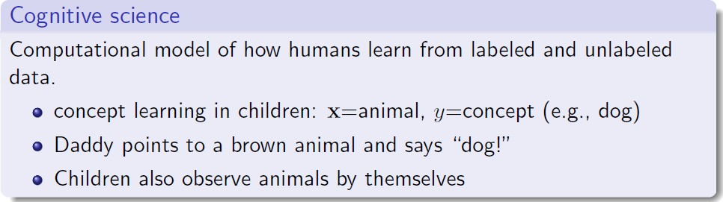
Semi-Supervised learning in Humans
6

Slide 7







Can unlabeled data help?
Positive labeled data Negative labeled data Unlabeled data
Supervised Decision Boundary
Semi-Supervised Decision Boundary
Assume each class is a coherent group (e.g. Gaussian)
Then unlabeled data can help identify the boundary more accurately.
7

Slide 8
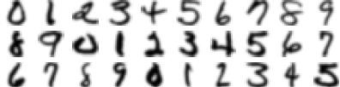

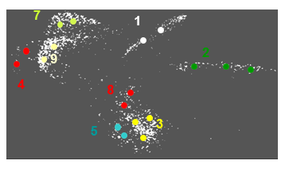
Can unlabeled data help?
“0” “1” “2” …
This embedding can be done by manifold learning algorithms
“Similar” data points have “similar” labels
8

Slide 9

Some SSL Algorithms
Self-Training
Generative methods, mixture models
Graph-based methods
Co-Training
Semi-supervised SVM
Many others
9

Slide 10

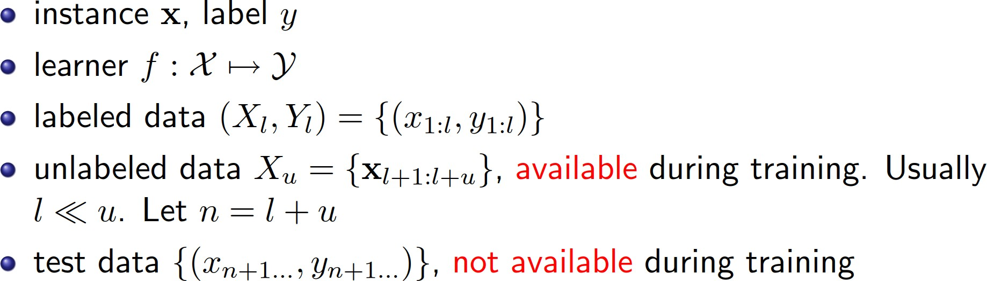
Notation
10

Slide 11


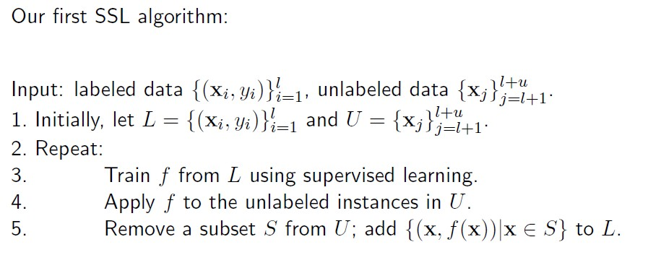
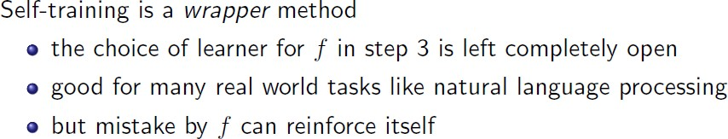
Self-training
11

Slide 12
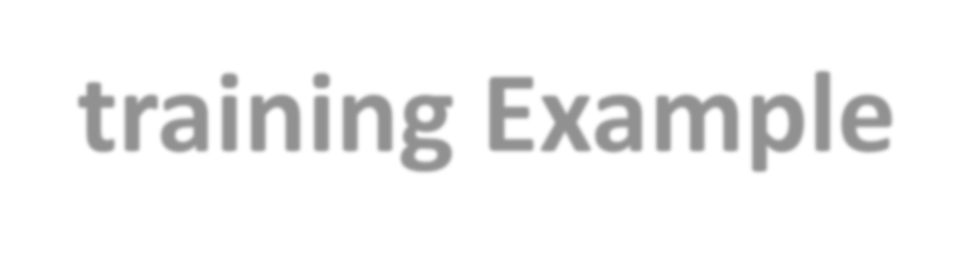
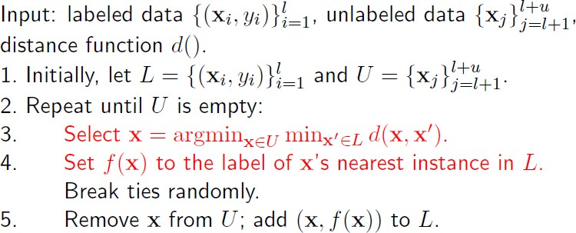
Self-training Example
Propagating 1-NN
12

Slide 13
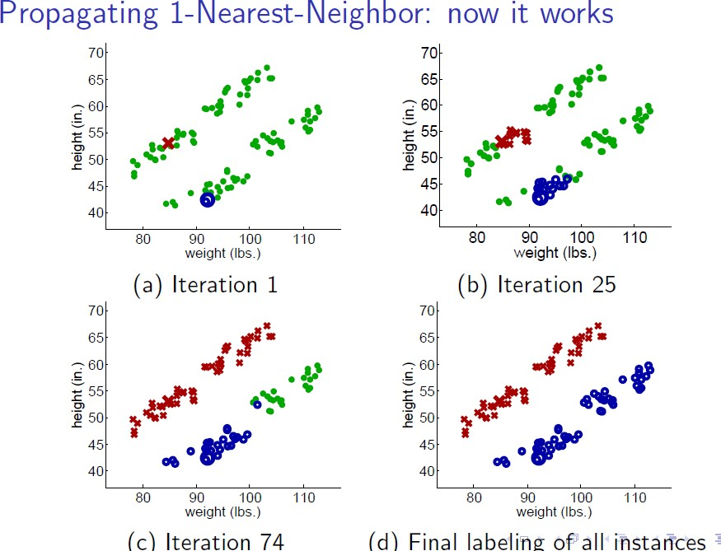

Slide 14
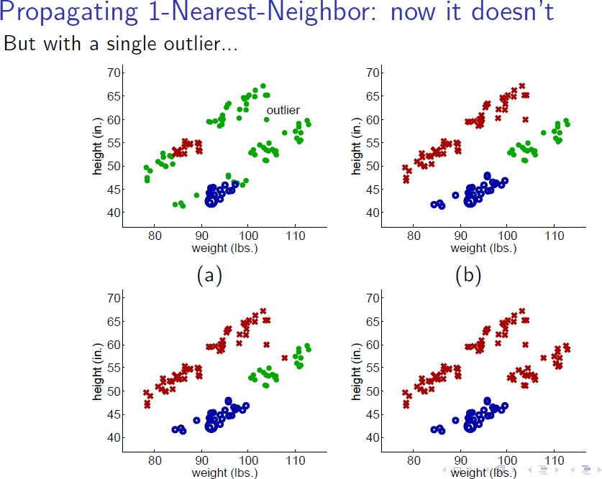

Slide 15

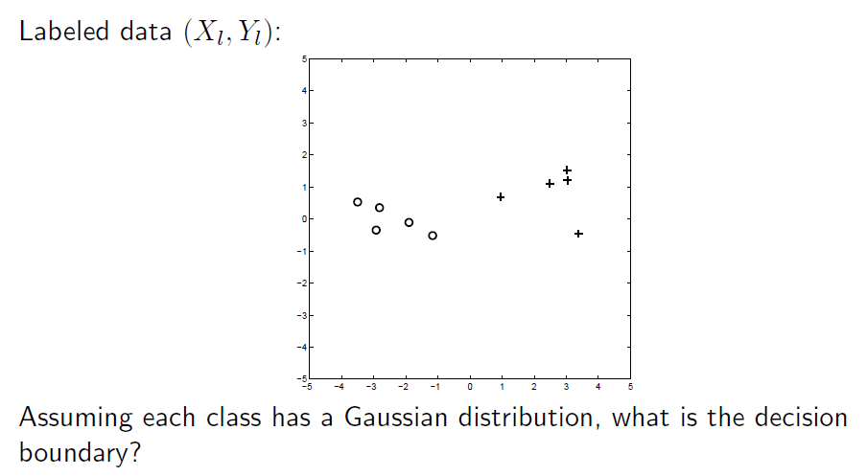
Mixture Models for Labeled Data
15

Slide 16
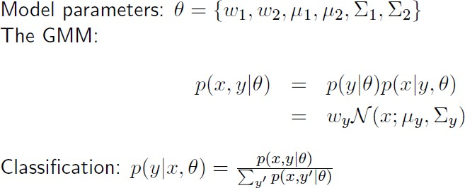
Mixture Models for Labeled Data
Estimate the parameters from the labeled data
>< 1/2
Decision for any test point not in the labeled dataset
16

Slide 17
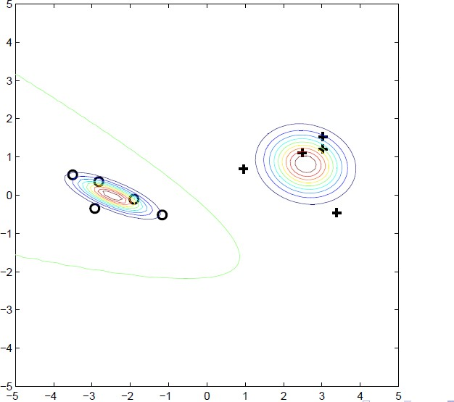
Mixture Models for Labeled Data

Slide 18


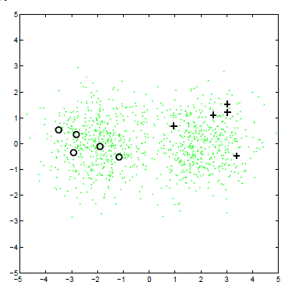
Mixture Models for SSL Data

Slide 19

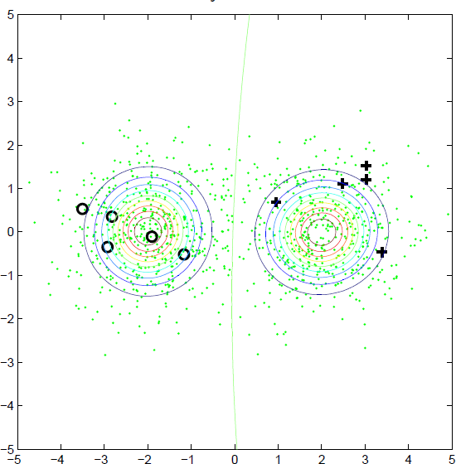
Mixture Models

Slide 20


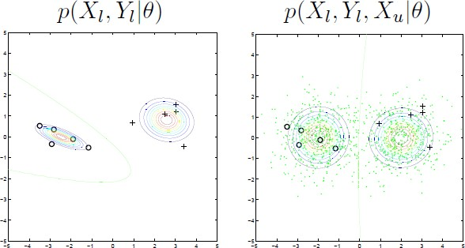
Mixture Models SL vs SSL

Slide 21
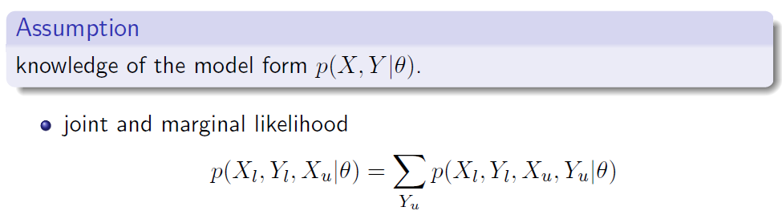
Mixture Models

Slide 22

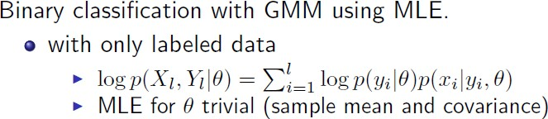
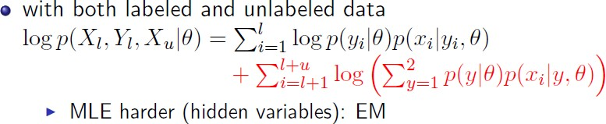
Gaussian Mixture Models

Slide 23

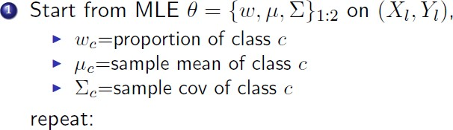
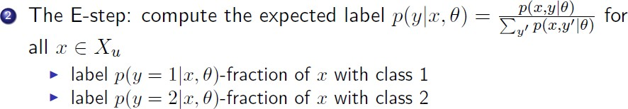
EM for Gaussian Mixture Models

Slide 24

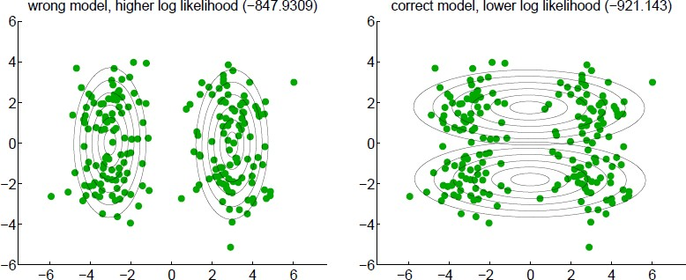
Assumption for GMMs

Slide 25
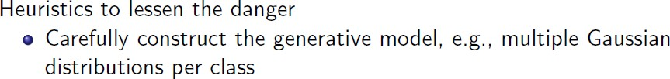
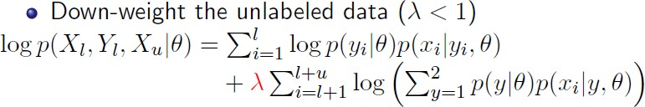
Assumption for GMMs

Slide 26

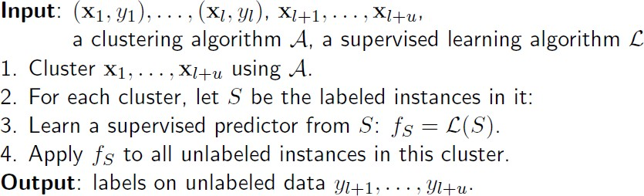
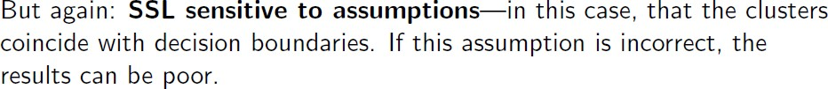
Related: Cluster and Label

Slide 27
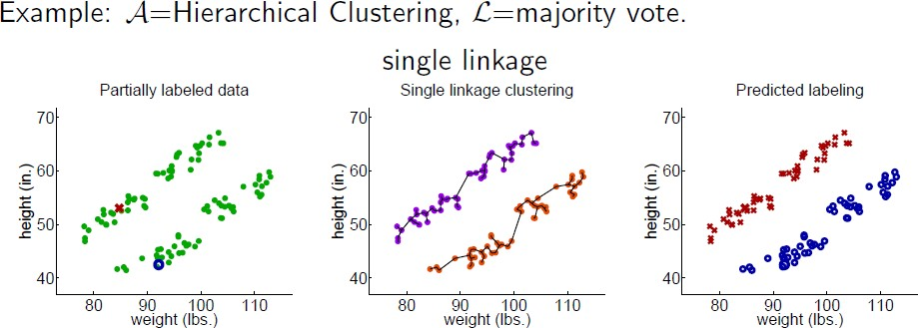
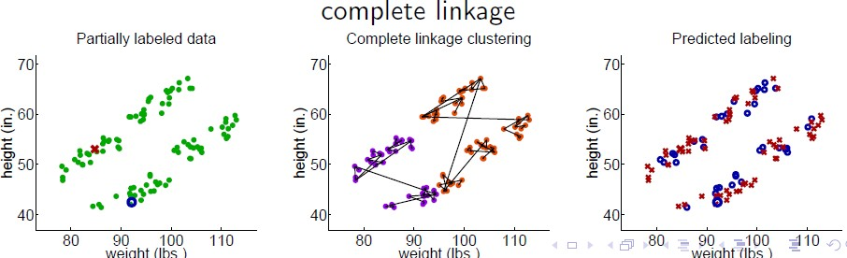

Slide 28
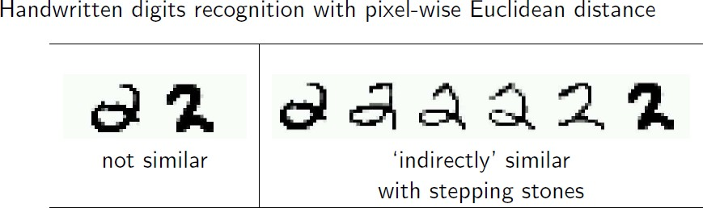
Graph Based Methods
Assumption: Similar unlabeled data have similar labels.

Slide 29

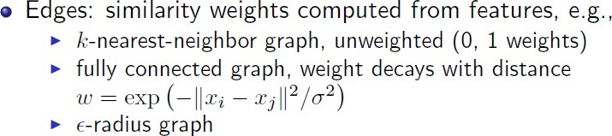

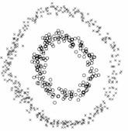
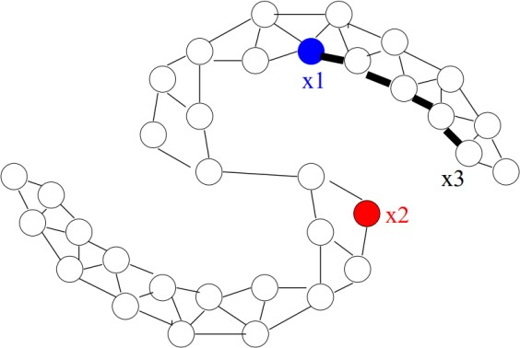
Graph Regularization
Similarity Graphs: Model local neighborhood relations between data points
Assumption:
Nodes connected by heavy edges tend to have similar label

Slide 30
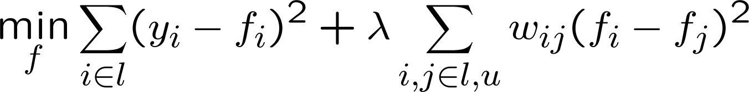
Graph Regularization
If data points i and j are similar (i.e. weight w_{ij} is large), then their labels are similar f_{i} = f_{j}
Loss on labeled data (mean square,0-1)
Graph based smoothness prior on labeled and unlabeled data

Slide 31


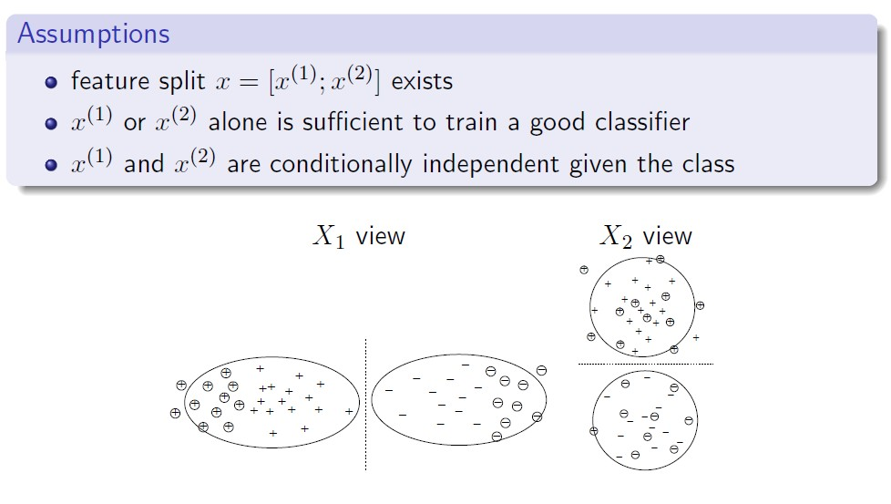
Co-training

Slide 32

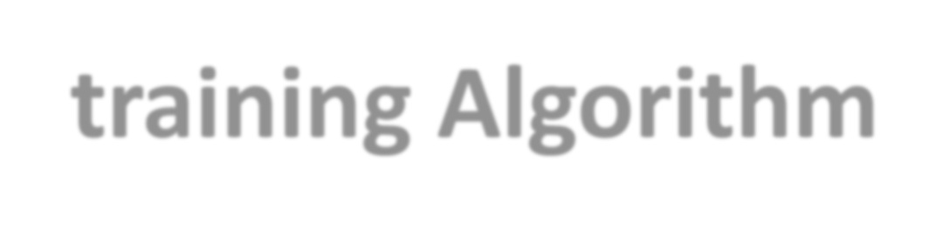
Co-training Algorithm
Co-training (Blum & Mitchell, 1998) (Mitchell, 1999) assumes that
features can be split into two sets;
each sub-feature set is sufﬁcient to train a good classiﬁer.
Initially two separate classiﬁers are trained with the labeled data, on
the two sub-feature sets respectively.
Each classiﬁer then classiﬁes the unlabeled data, and ‘teaches’ the other classiﬁer with the few unlabeled examples (and the predicted labels) they feel most conﬁdent.
Each classiﬁer is retrained with the additional training examples given
by the other classiﬁer, and the process repeats.
33

Slide 33
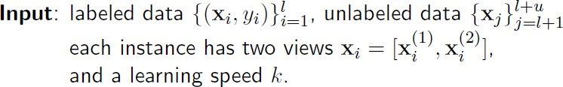
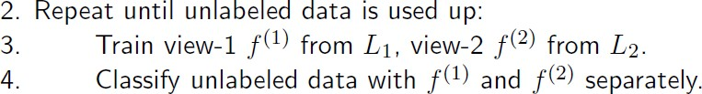
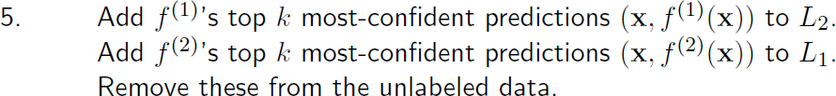
Co-training Algorithm
Blum & Mitchell’98

Slide 34


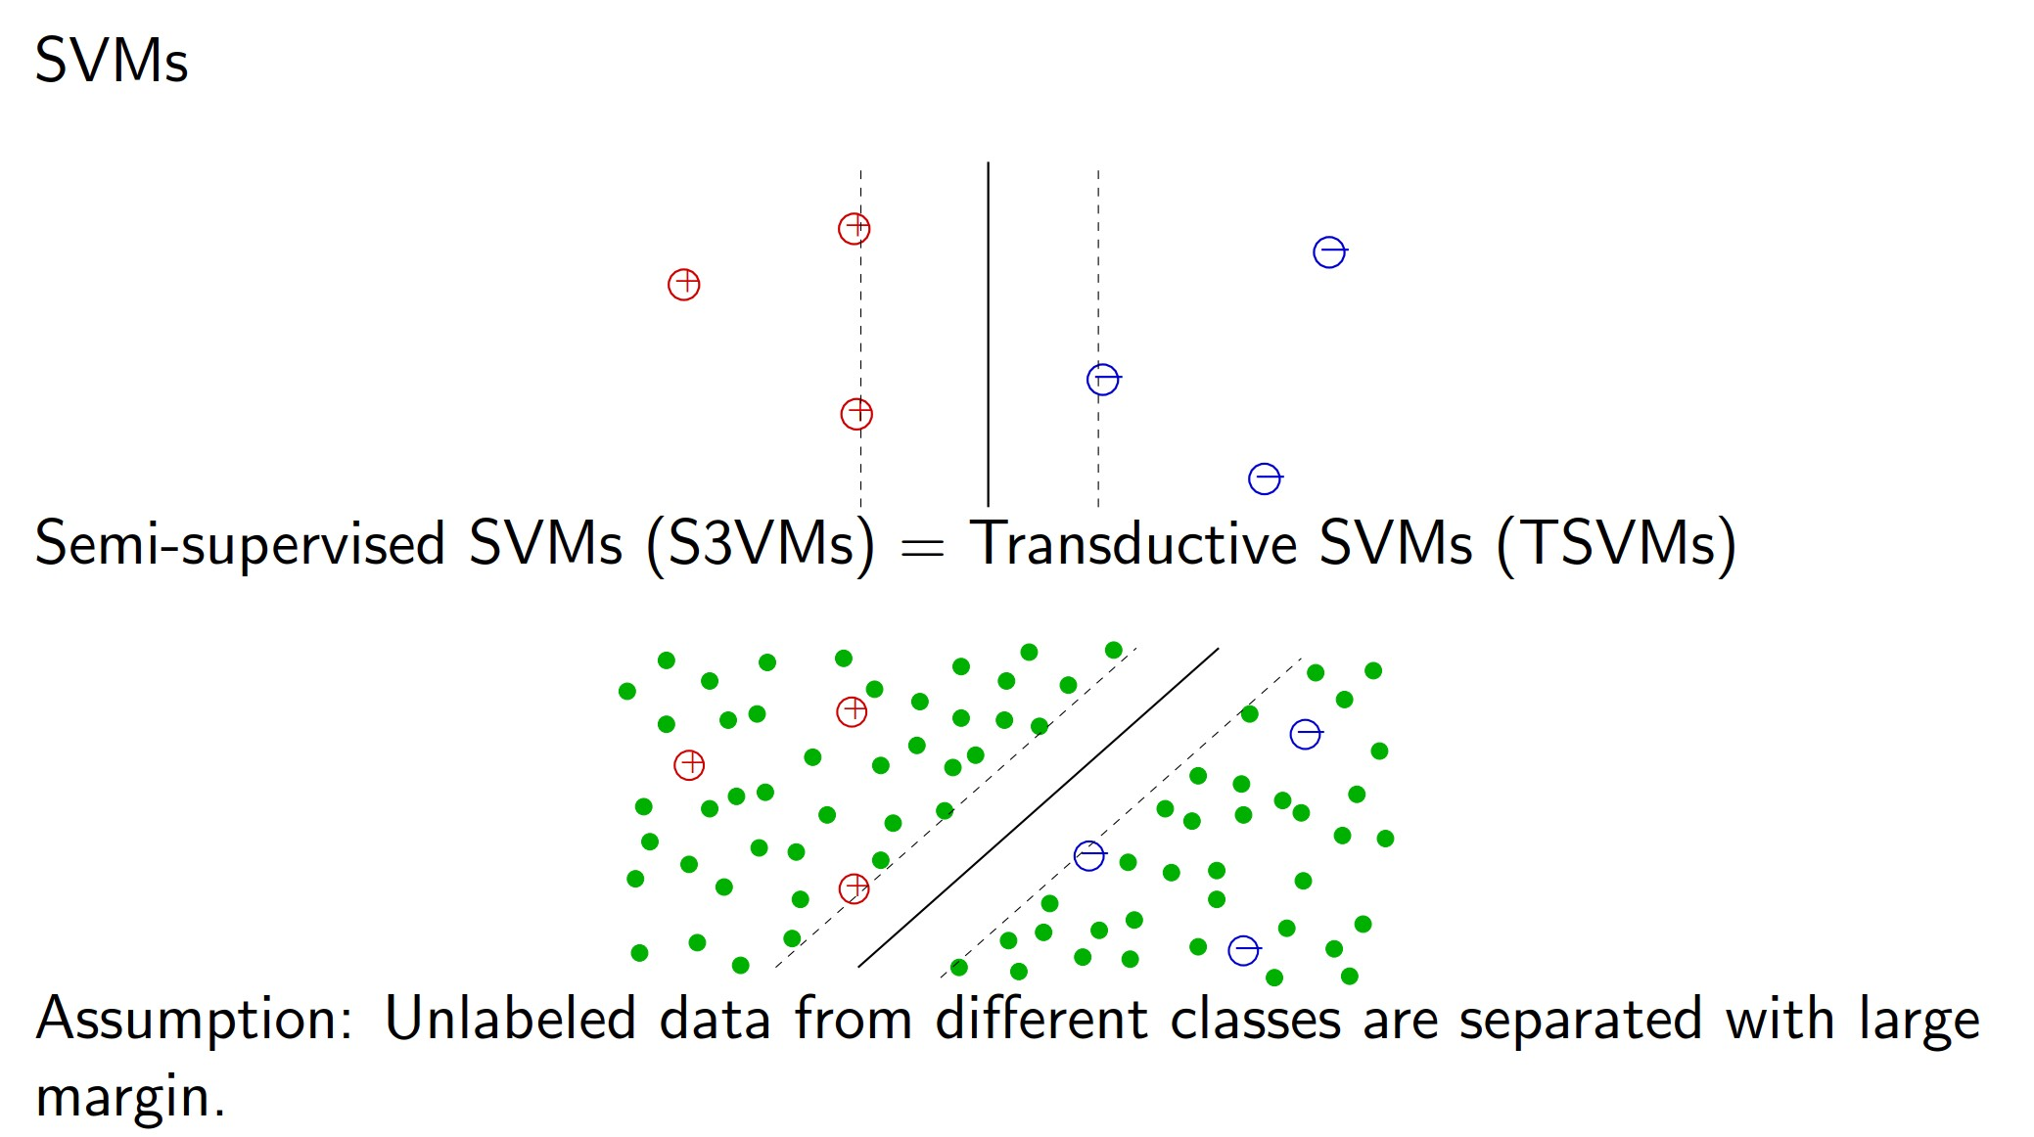
Semi-Supervised SVMs
34

Slide 35

Semi-Supervised Learning
Generative methods
Graph-based methods
Co-Training
Semi-Supervised SVMs
Many other methods
SSL algorithms can use unlabeled data to help improve
prediction accuracy if data satisfies appropriate assumptions
35

Slide 36
Dimensionality Reduction using Nonlinear Manifold Learning
Many datasets (especially data streams) contain essential nonlinear structures that are invisible to PCA and other techniques like multidimensional scaling (MDS).
ISOMAP, Local Linear Embedding (LLE), and Laplacian Eigenmap algorithms help to understand the structure of high dimensional dataset based on manifold learning.
One of the earliest approaches to manifold learning is the Isomap algorithm, short for Isometric Mapping.
Isomap seeks a lower-dimensional embedding which maintains geodesic distances between all points.
Locally linear embedding (LLE) seeks a lower-dimensional projection of the data which preserves distances within local neighborhoods.
LLE can be thought of as a series of local Principal Component Analyses which are globally compared to find the best non-linear embedding.

Slide 37
Case study: Geodesic paths for nonlinear dimensionality reduction for “Swiss roll” dataset using ISOMAP
Euclidean distance Neighborhood graph Two-dimensional embedding
vs. Geodesic distance
Source: J. B. Tenenbaum, V. De Silva, J. C. Langford, A global geometric framework for nonlinear dimensionality reduction. Science, 290(5500), 2319-2323.

